Slide 1




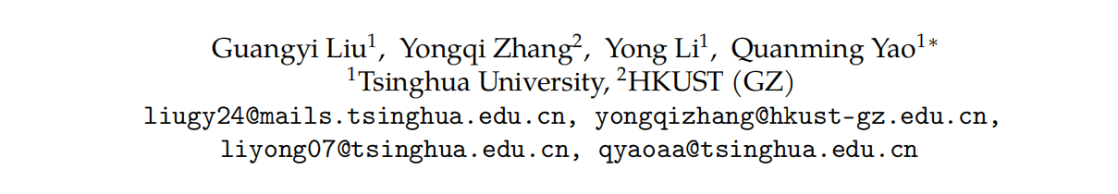





ATAI
Advanced Technique of Artificial Intelligence
ATAI
ChongqingUniversity _{AdvancedTechniqueof}
of Technology Artificial Intelligence
Chongqing University of
Technology
Chongqing University ^{ATAI}
_{of Technology} Advanced Techniqueof
Artificial Intelligence
Chongqing University of Technology
Chongqing University of Technology
Dual Reasoning: A GNN-LLM Collaborative
Framework for Knowledge Graph Question Answering
Code:https://github.com/leolouis14/DualR
——NeurIPS 2025
Reported by Xiang Zhang
1

Slide 2
ATAI
Advanced Technique of Artificial Intelligence
ATAI
ChongqingUniversity _{AdvancedTechniqueof}
of Technology Artificial Intelligence
Chongqing University of
Technology
Chongqing University ^{ATAI}
_{of Technology} Advanced Techniqueof
Artificial Intelligence
Chongqing University of Technology
Chongqing University of Technology
Motivation
(1)To further enhance LLMs’ reasoning abilities, many approaches (e.g., Chain-of-Thought (CoT)) guide LLMs to generate intermediate steps and form a complete thought chain, aiming for a more deliberate and explicit reasoning. While these approaches can improve performance, they typically increase inference costs, and encounter the challenge of hallucinations when the model lacks relevant knowledge, especially domain-specific and up-to-date knowledge.
(2)Existing methods frequently overlook the importance of explicit learning within graph structures, which is essential for supplying precise evidence chain for LLM’s reasoning.

Slide 3
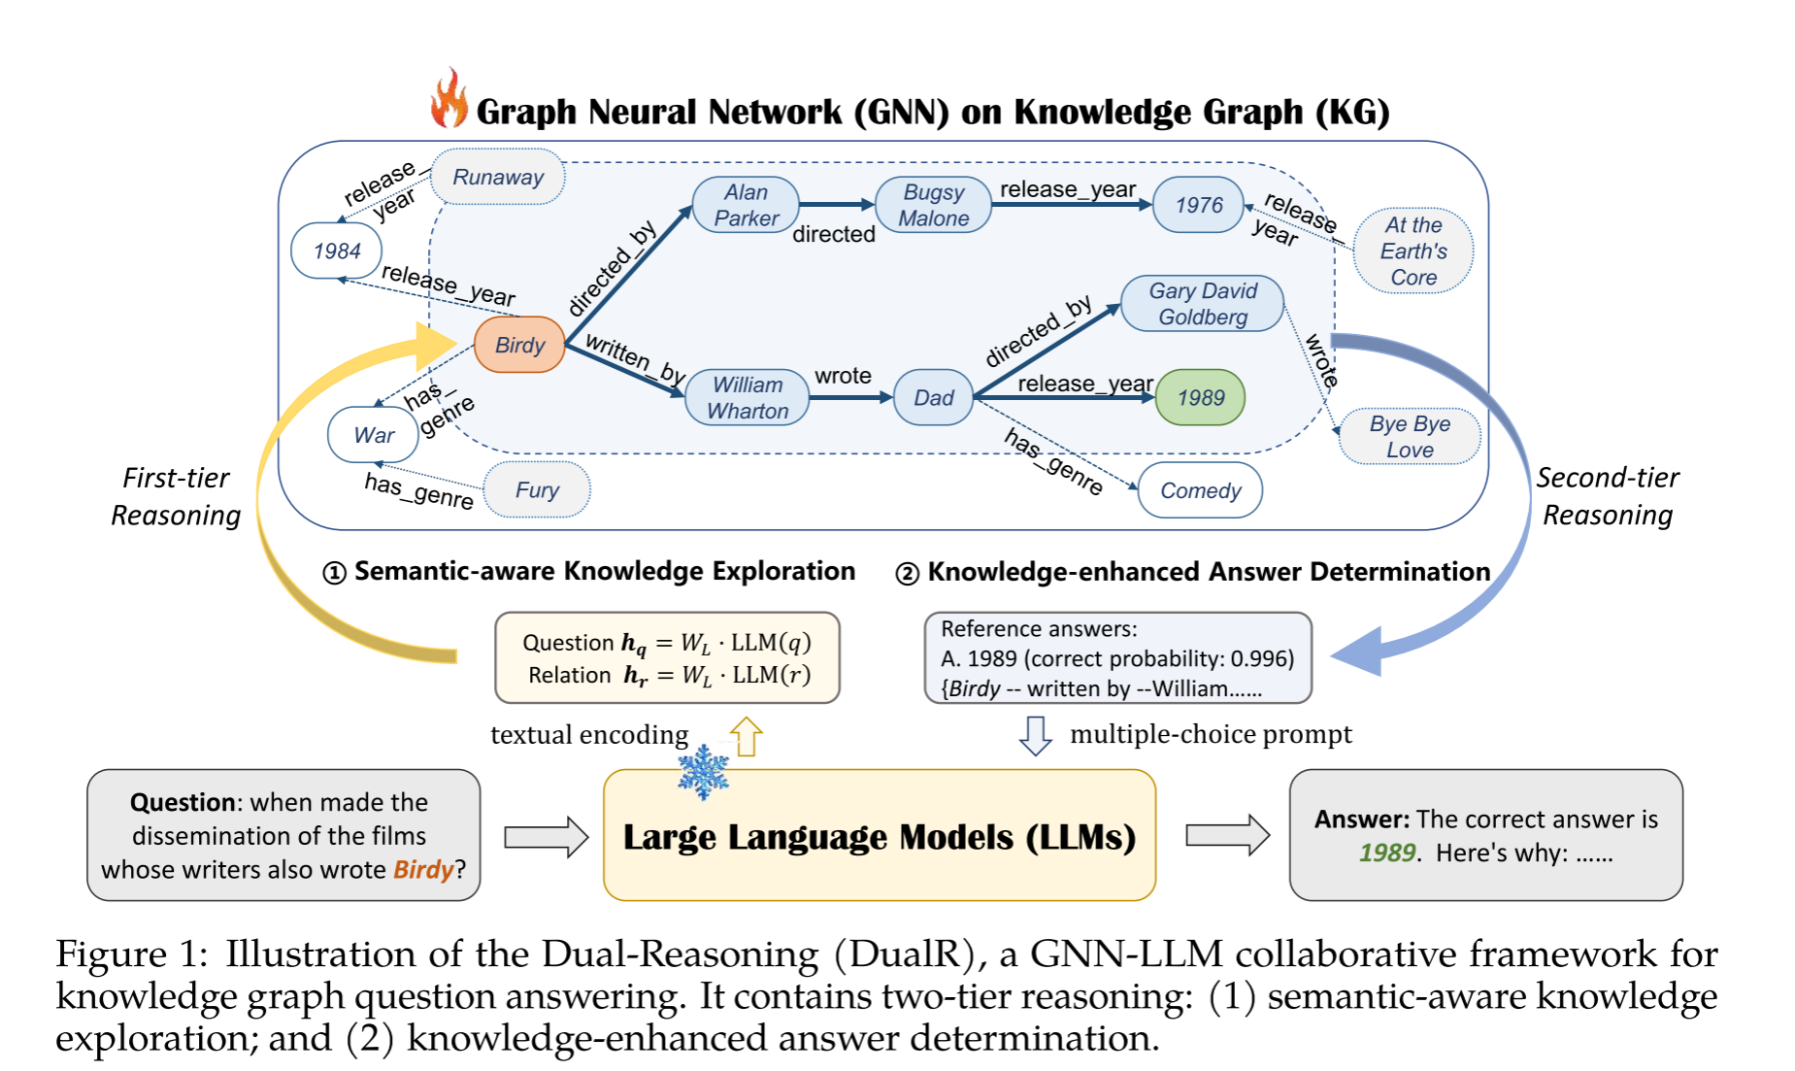
ATAI
Advanced Technique of Artificial Intelligence
ATAI
ChongqingUniversity _{AdvancedTechniqueof}
of Technology Artificial Intelligence
Chongqing University of
Technology
Chongqing University ^{ATAI}
_{of Technology} Advanced Techniqueof
Artificial Intelligence
Chongqing University of Technology
Chongqing University of Technology
Overview

Slide 4
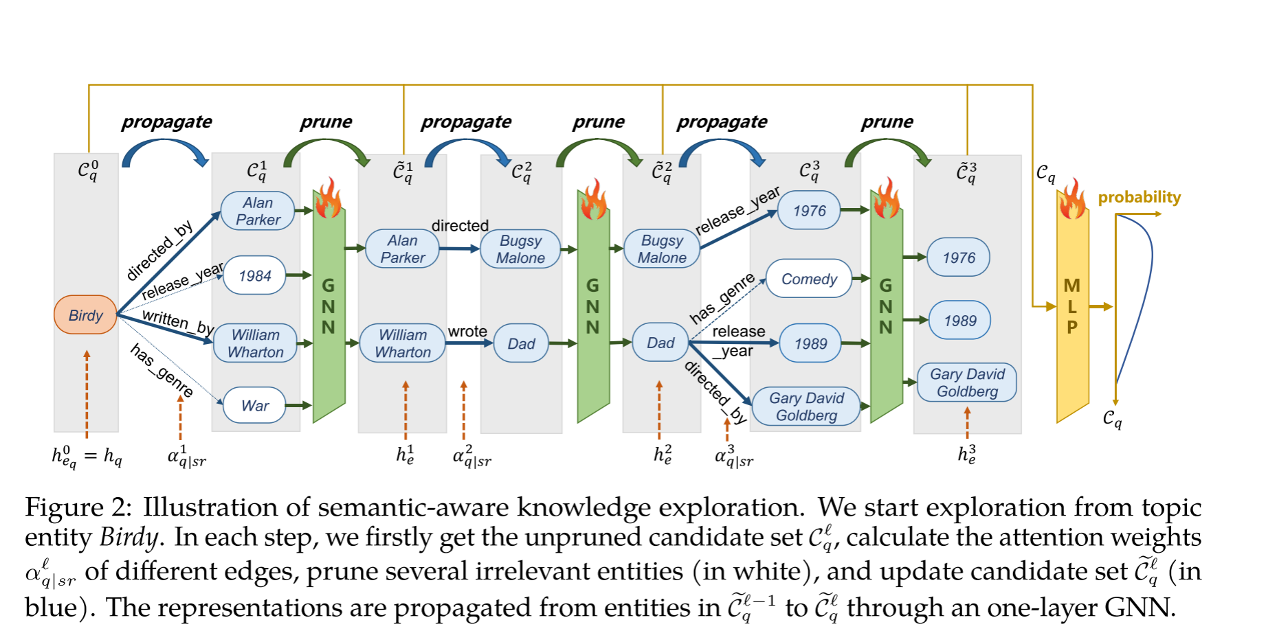
ATAI
Advanced Technique of Artificial Intelligence
ATAI
ChongqingUniversity _{AdvancedTechniqueof}
of Technology Artificial Intelligence
Chongqing University of
Technology
Chongqing University ^{ATAI}
_{of Technology} Advanced Techniqueof
Artificial Intelligence
Chongqing University of Technology
Chongqing University of Technology
Overview

Slide 5
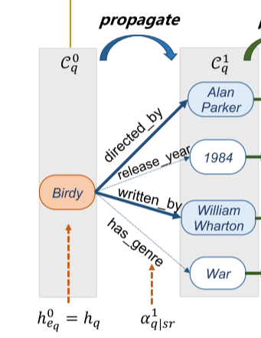
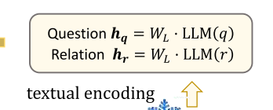

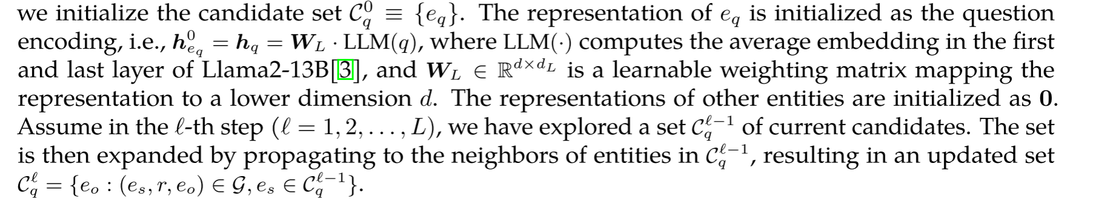
ATAI
Advanced Technique of Artificial Intelligence
ATAI
ChongqingUniversity _{AdvancedTechniqueof}
of Technology Artificial Intelligence
Chongqing University of
Technology
Chongqing University ^{ATAI}
_{of Technology} Advanced Techniqueof
Artificial Intelligence
Chongqing University of Technology
Chongqing University of Technology
Method

Slide 6
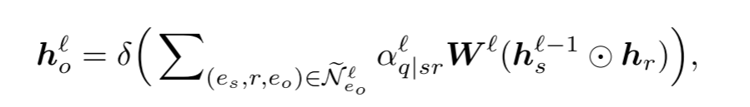
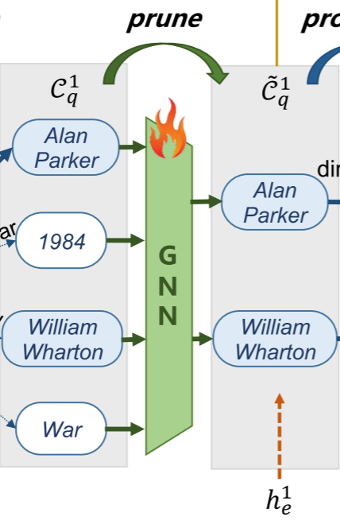
ATAI
Advanced Technique of Artificial Intelligence
ATAI
ChongqingUniversity _{AdvancedTechniqueof}
of Technology Artificial Intelligence
Chongqing University of
Technology
Chongqing University ^{ATAI}
_{of Technology} Advanced Techniqueof
Artificial Intelligence
Chongqing University of Technology
Chongqing University of Technology
Method

Slide 7
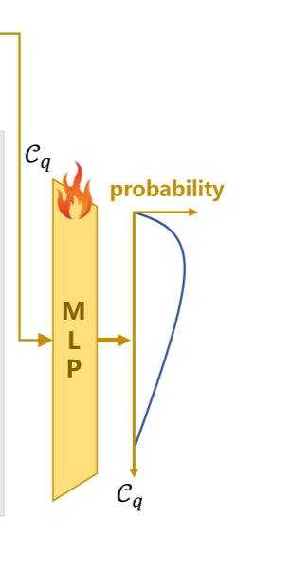
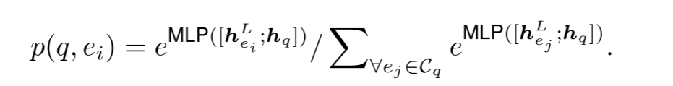
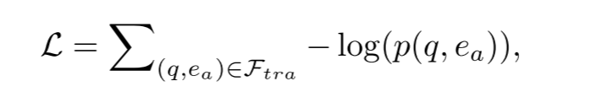
ATAI
Advanced Technique of Artificial Intelligence
ATAI
ChongqingUniversity _{AdvancedTechniqueof}
of Technology Artificial Intelligence
Chongqing University of
Technology
Chongqing University ^{ATAI}
_{of Technology} Advanced Techniqueof
Artificial Intelligence
Chongqing University of Technology
Chongqing University of Technology
Method

Slide 8
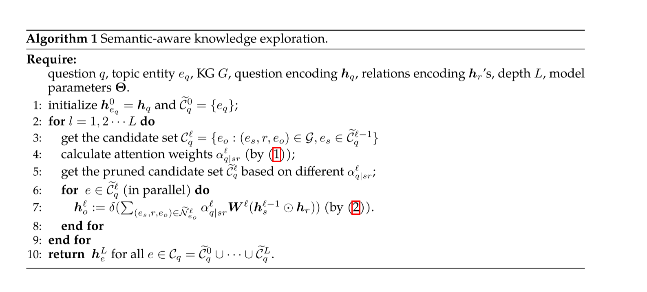
ATAI
Advanced Technique of Artificial Intelligence
ATAI
ChongqingUniversity _{AdvancedTechniqueof}
of Technology Artificial Intelligence
Chongqing University of
Technology
Chongqing University ^{ATAI}
_{of Technology} Advanced Techniqueof
Artificial Intelligence
Chongqing University of Technology
Chongqing University of Technology
Method

Slide 9
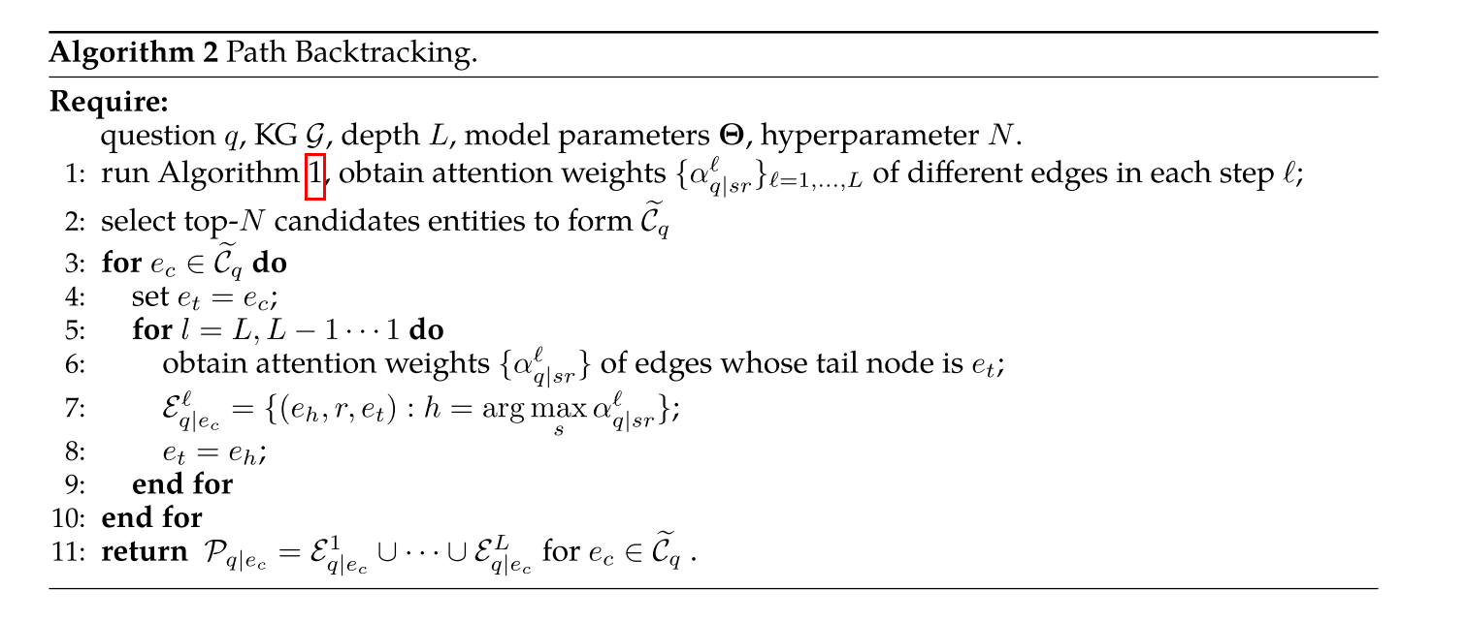
ATAI
Advanced Technique of Artificial Intelligence
ATAI
ChongqingUniversity _{AdvancedTechniqueof}
of Technology Artificial Intelligence
Chongqing University of
Technology
Chongqing University ^{ATAI}
_{of Technology} Advanced Techniqueof
Artificial Intelligence
Chongqing University of Technology
Chongqing University of Technology
Method

Slide 10
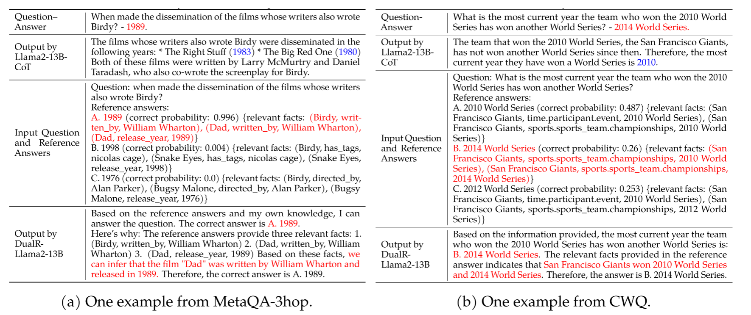
ATAI
Advanced Technique of Artificial Intelligence
ATAI
ChongqingUniversity _{AdvancedTechniqueof}
of Technology Artificial Intelligence
Chongqing University of
Technology
Chongqing University ^{ATAI}
_{of Technology} Advanced Techniqueof
Artificial Intelligence
Chongqing University of Technology
Chongqing University of Technology
Method

Slide 11
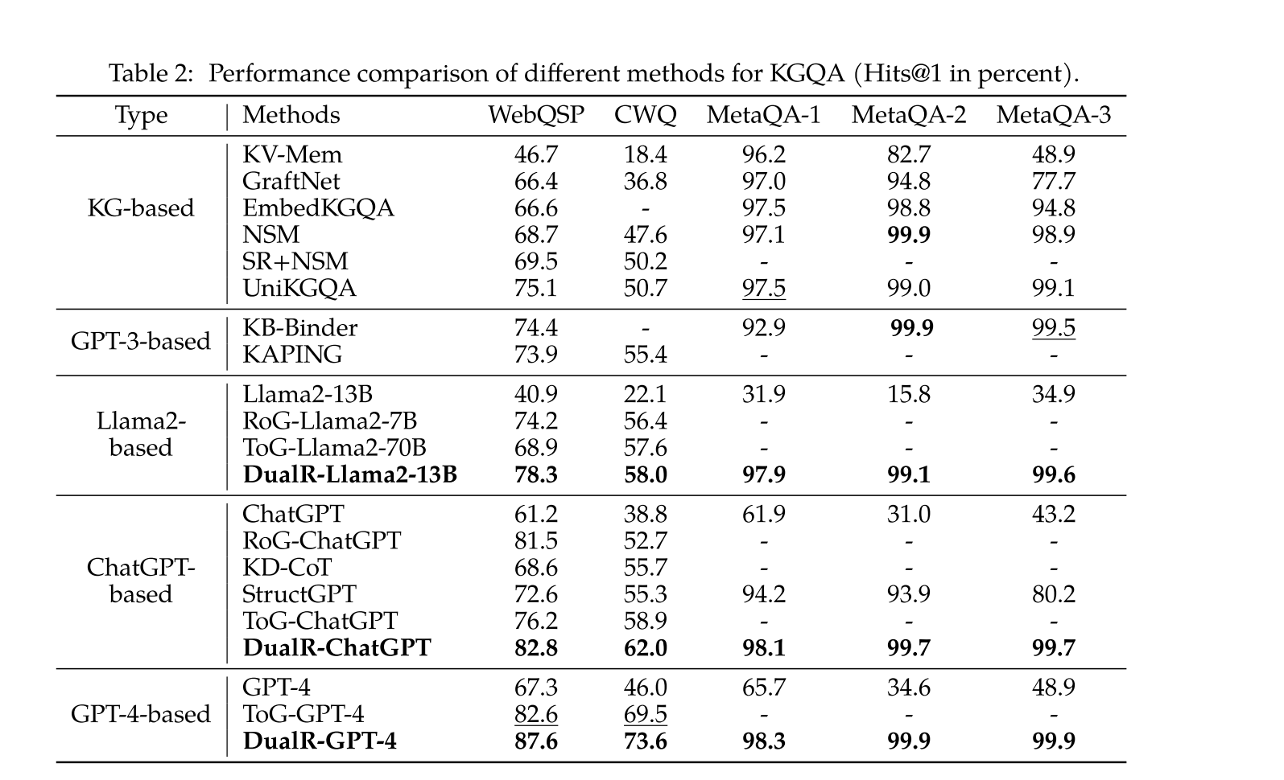
ATAI
Advanced Technique of Artificial Intelligence
ATAI
ChongqingUniversity _{AdvancedTechniqueof}
of Technology Artificial Intelligence
Chongqing University of
Technology
Chongqing University ^{ATAI}
_{of Technology} Advanced Techniqueof
Artificial Intelligence
Chongqing University of Technology
Chongqing University of Technology
Experiments

Slide 12
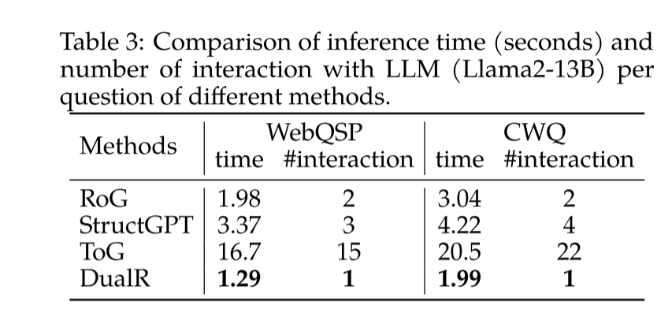
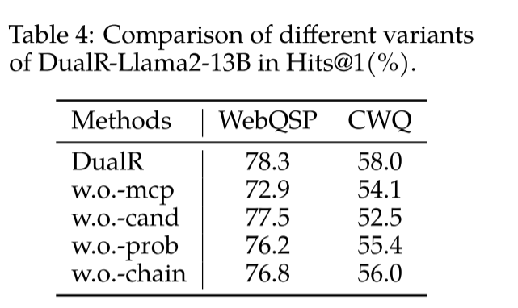
ATAI
Advanced Technique of Artificial Intelligence
ATAI
ChongqingUniversity _{AdvancedTechniqueof}
of Technology Artificial Intelligence
Chongqing University of
Technology
Chongqing University ^{ATAI}
_{of Technology} Advanced Techniqueof
Artificial Intelligence
Chongqing University of Technology
Chongqing University of Technology
Experiments

Slide 13
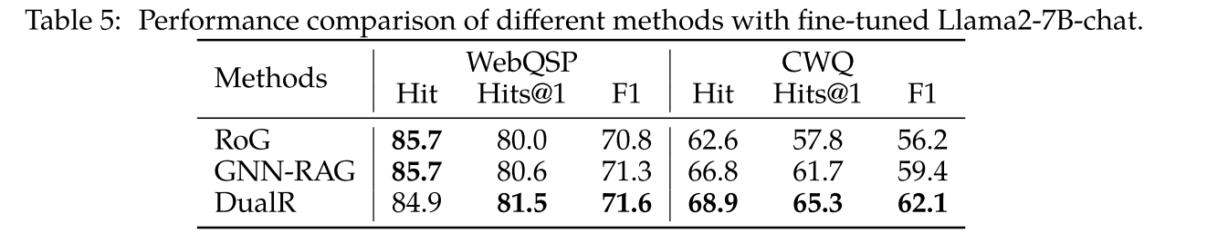
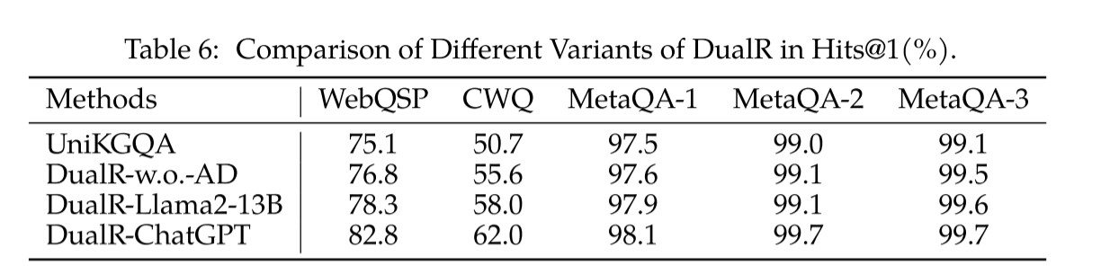
ATAI
Advanced Technique of Artificial Intelligence
ATAI
ChongqingUniversity _{AdvancedTechniqueof}
of Technology Artificial Intelligence
Chongqing University of
Technology
Chongqing University ^{ATAI}
_{of Technology} Advanced Techniqueof
Artificial Intelligence
Chongqing University of Technology
Chongqing University of Technology
Experiments

Slide 14
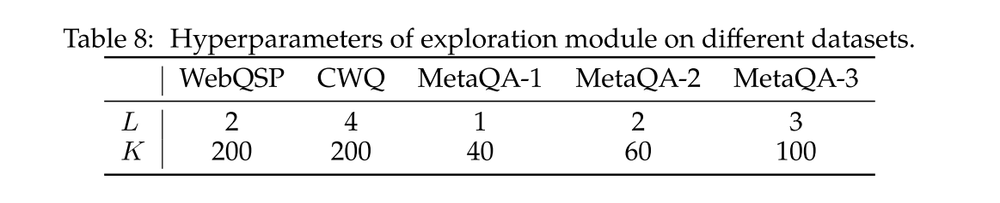
ATAI
Advanced Technique of Artificial Intelligence
ATAI
ChongqingUniversity _{AdvancedTechniqueof}
of Technology Artificial Intelligence
Chongqing University of
Technology
Chongqing University ^{ATAI}
_{of Technology} Advanced Techniqueof
Artificial Intelligence
Chongqing University of Technology
Chongqing University of Technology
Experiments

Slide 15


ATAI
Advanced Technique of Artificial Intelligence
ATAI
ChongqingUniversity _{AdvancedTechniqueof}
of Technology Artificial Intelligence
Chongqing University of
Technology
Chongqing University ^{ATAI}
_{of Technology} Advanced Techniqueof
Artificial Intelligence
Chongqing University of Technology
Chongqing University of Technology
Thanks!

